Slide 1

Recipe Creator and Manager
Presented By
Group 14
JADE GOSAR
OKECHUKWU AGOMUO
MELANIEANTHONY VADAKKEPEEDIKA

Slide 2
Agenda
Definition of a Recipe Creator and Manager
Approach to the Project
Database/CRUD implementation
Object Oriented Programming (OOP)
Ethical Considerations and Critical Thinking
Database Design – Entity Relationship Diagram
Demo (With PyCharm)
References

Slide 3
Recipe Creator and Manager
A recipe creator and manager is a program that can be used to create, store, organize and manage recipes
It comprises features the that allow users to add new recipes, categorize them, and also search for recipes based on ingredients or categories

Slide 4
Approach to the Project
Python reads data from a flat csv file into the database
Recipe, ingredients, and user data stored in three tables
Applied Object Oriented Programming (OOP)
Implemented CRUD (Create, Read, Update, Delete) operations
Error Handling to deal with potential errors gracefully
Menu-driven interface for user interaction

Slide 5
Database/CRUD implementation
SQLite, a lightweight relational database used to store data
Functions defined for each CRUD (Create, Read, Update, Delete) operation

Slide 6
Object Oriented Programming
Created classes for Recipe, Ingredient and User with appropriate attributes and methods related to each class’ respective entity
Ingredients class inherits attributes from Recipe

Slide 7
Ethical Considerations & Critical Thinking
To ensure privacy and security of user data, we incorporated critical thinking and addressed several ethical considerations, such as:
User Consent – safeguards in place to protect user intentions
Data Privacy – hence the use of a database
User-friendly Interface – enabling user interaction and navigation
Error Handling – to gracefully handle potential exceptions
Deletion confirmation – prompts user to confirm before deletion
User management – id created by user, can only delete if id # is known

Slide 8
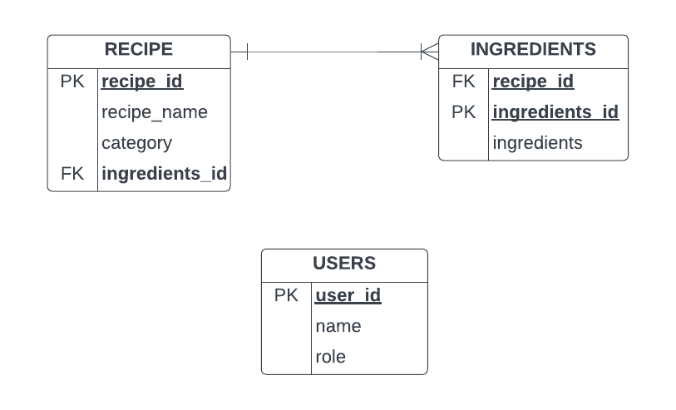
Database Entity Relationship Diagram

Slide 9
Demo With PyCharm

Slide 10
References
https://hoteltechreport.com/news/recipe-management-software
https://www.techtarget.com/searchapparchitecture/definition/object-oriented-programming-OOP?Offer=abt_pubpro_AI-Insider
https://www.prepbytes.com/blog/python/crud-operations-in-python/
https://www.isaca.org/resources/isaca-journal/issues/2016/volume-6/an-ethical-approach-to-data-privacy-protection
https://www.tpximpact.com/knowledge-hub/insights/ethical-data-collection/
https://docs.swift.org/swift-book/documentation/the-swift-programming-language/errorhandling/

Slide 11
Thank You

